Slide 1
35
Discrete Mathematics
Matrices and Matrix Operations

Slide 2






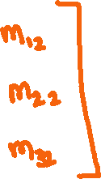











Slide 3










Slide 4




















Slide 5













Slide 6

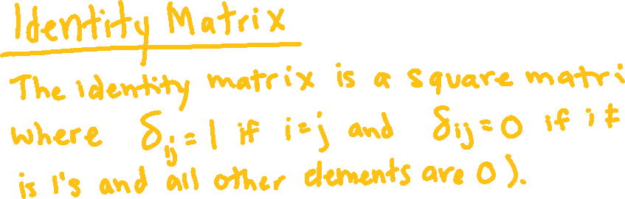





Slide 7























Slide 8
Up Next…
Matrix Operations on your TI-84

